Slide 2
Head to Head: Azure Stack vs Azure Pack

Slide 3
Session Abstract
Azure Pack is built on the proven System Centre stack, and will be supported by Microsoft until 2022; Azure Stack brings the public resource manager on premise, with fabric resource providers.
Learn how these products work, what the share in common, and how to differ. Each solution has a place in our datacentre's, learn which is the correct solution for your implementation, and why!.

Slide 4

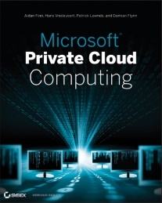
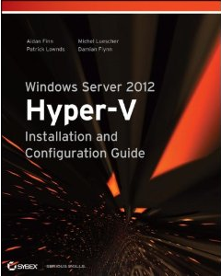
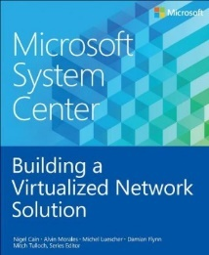

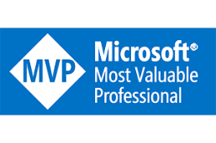

Damian Flynn
MVP System Center
www.DamianFlynn.com
@damian_flynn

Slide 5

Important
The content covered in this presentation is based on personal experience with the current public preview.
Information shared is not endorsed by Microsoft, and is subject to product change’s prior to release.

Slide 6

Agenda
Architecture
Resource Manager
Head to Head

Slide 7
The Evolution from Pack to Stack

Slide 8






Azure to Windows Azure Pack
Web Sites
Apps
Database
VMs
Service
Plans
Users
Web Sites
Apps
Database
VMs
Subscriber Self-Service Portal
Self Service Portal Moves On-Premises
Provider Portal
Consumer Self-Service Portal
Service Management API
Common Mgt. Experience
Service Management API
Future Services
Worker
Role
Web
Sites
VMs
SQL
Service
Bus
Caching
Other
Services
CDN.
Media,, etc.
Cloud-Enabled Services Move On-Premises
Web
Sites
VMs
SQL
Service
Bus
SMA
R2 w/ Service Provider Foundation
Workloads
R2
Consistent Dev. Experience

Slide 9

Windows Azure Pack to Azure Stack
Service
Plans
Users
Web Sites
Apps
Database
VMs
Admin
Web Sites
Apps
Database
VMs
Provider Portal
Consumer Self-Service Portal
Portal Includes RBAC Blades for Admin’s
Self-Service Portal
Service Management API
Common Mgt. Experience
Service Management API
Future Services
Azure Resource Manager
IaaS
SQL
MySQL
Web Apps
SMA
Fabric Management
Compute
RP
NetworkRP
Storage RP
IaaS
RP
SQL
RP
MySQL RP
Web Apps
R2 w/ Service Provider Foundation
R2
2016
Datacenter Workloads

Slide 10
Core Architecture

Slide 11
Architecture Concept
Portal & Tools
Network
Compute
Image
Blob
Block
Identity

Slide 12
Windows Azure Pack
Portal
Tools
Service Management API
Web Sites
Virtual Machines
Databases
Management Automation
Service Bus
Controller
(Web farm framework)
SPF API
(Service Provider Framework)
Database API
SMA API
(Service Management Automation)
Gateway
Web Farm
Front-end/Workers
(Application Request Routing)
System Center
(Virtual Machine Manager Component)
MS SQL Database
MySQL Database
Runbook Services
(SMA Runbook Component)
Message Broker Service
Windows Server
Windows Server
Windows Server
Windows Server
Windows Server

Slide 13
Windows Azure Stack
Portal
Tools
Service Management API
Azure Resource Manager
Foundation Services
Core Service
Additional Services
Gallery
Compute
Network
Storage
Platform
SQL
Events
Events
Events
Events
Events
Web
Subscriptions
Events
Gallery
Gallery
Gallery
Gallery
Gallery
Gallery
Metrics
Metrics
Metrics
Metrics
Metrics
Metrics
Metrics
Admin API
Admin API
Admin API
Admin API
Admin API
Admin API
Tenant API
Tenant API
Tenant API
Tenant API
Usage
Tenant API
Tenant API
Usage
Usage
Usage
Usage
Usage
Usage
Manifest
Manifest
Manifest
Manifest
RBAC
Manifest
Manifest
Quota
Quota
Quota
Quota
Quota
Quota

Slide 14
Decision’s and Influencer’s

Slide 15
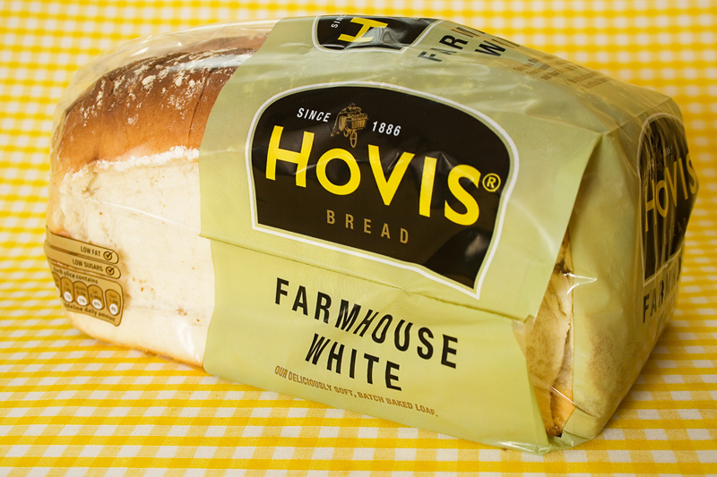
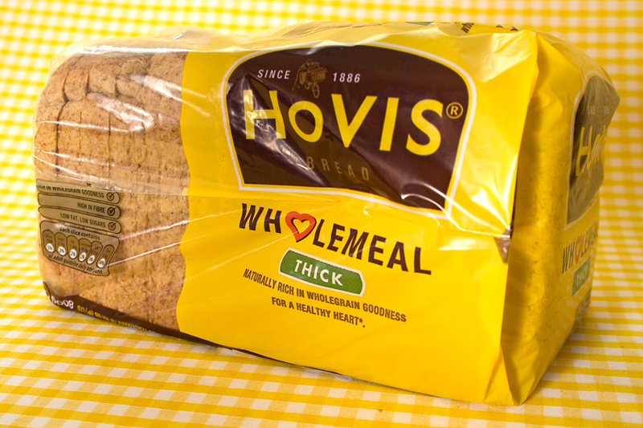
Choices, Choices, Choices…

Slide 16
WAP
With VMM2016
On Premise Cloud Stacks
WAP
With VMM2012R2
MAS
Preview Release

Slide 17
Windows Azure Pack with Virtual Machine Manager 2012R2 will be End of Mainstream support from July 2017.

Slide 18
Compute
Microsoft Azure Stack
Azure Pack & VMM 2012
Azure Pack
& VMM 2016
Management
CRP
SPF
& VMM 2012
SPF
& VMM 2016
Hypervisors
Hyper-V 2016
Hyper-V, Xen
& VMware
Hyper-V
& VMware
Virtual Machine Naming Policy
❒
RP Policies
✓
VM Name Sync (UR4)
Memory Type
Static
Static & Dynamic
Memory Hot Resize
❒
❒
✓
Virtual Machine Disks
VHD
VHD, VHDX, Shared VHDX
Multiple Network Interfaces
✓
✓
UR4 Feature
Virtual Network Hot Add & Remove
❒
❒
✓

Slide 19
Compute
Microsoft Azure Stack
Azure Pack & VMM 2012
Azure Pack
& VMM 2016
ISO Attachment
✓
✓
✓
Disaster Recovery
❒
✓
Azure Site Recovery
High Availability
✓
❒
In Portal Monitors
✓
Guest Metrics
✓
Checkpoints
❒
✓
UR7 Feature
& UR8 Enhanced
Virtualisation Technology
Hyper-V Gen 1
Hyper-V Gen 1 & 2
Virtual Machine Console
Diagnostic Screen Shots
VM Console via Gateway
Gallery
Image Repository
WAP Gallery & VMM Templates

Slide 20
Network
Microsoft Azure Stack
Azure Pack & VMM 2012
Azure Pack
& VMM 2016
Isolation Technology
Software Defined
Software Defined & VLAN
Gateways
NAT & Site2Site
NAT, Site2Site
& Routed
NAT & Site2Site
3rd Party Virtual Switch Extensions
❒
Net Fnct’s
✓
(UR5) SDNv1: Cisco, 5Nine…
Software Defined Network Protocols
VXLAN & NVGRE
NVGRE
VXLAN & NVGRE
Software Defined Network Availability
Network Controller
SCVMM Function
Network Controller
VPN Gateway Protocols
GRE, IPSEC, BGB, SSTP
GRE, IPSEC
GRE, IPSEC, BGB, SSTP
Multiple NAT Addresses
✓
✓
UR4 Feature
Virtual Network Functions
✓
❒
✓

Slide 21
Security
Microsoft Azure Stack
Azure Pack & VMM 2012
Azure Pack
& VMM 2016
Authentication
AzureAD
JWT Claims
WinAuth Site or AD FS
Multi-Factor Support
AzureAD
AzureAD & 3rd Party
Role Based Access Control
✓
❒
3rd Party Extension
Secure Boot
❒
❒
✓
Shielded Virtual Machines
❒
❒
✓

Slide 22
Storage
Microsoft Azure Stack
Azure Pack & VMM 2012
Azure Pack
& VMM 2016
Blob Storage
✓
❒
Quotas and Resources
✓
❒
SAN, NAS, Storage Spaces
❒
✓
Storage Spaces Direct
✓
❒
✓

Slide 23
Automation
Microsoft Azure Stack
Azure Pack & VMM 2012
Azure Pack
& VMM 2016
Runbook Dashboard (In Portal)
❒
✓
✓
Runbook Editor (In Portal)
❒
✓
✓
Runbook Triggers
❒
✓
✓
Web Hooks
❒
❒
❒

Slide 24
Windows Azure Pack with Azure Web Sites will be end of Mainstream support from July 2017.

Slide 25
Web Sites
Microsoft Azure Stack
Azure Pack & VMM 2012
Azure Pack
& VMM 2016
IPv6 Support
❒
✓
SSL Support
(UR7 Feature)
Virtual Directories
✓
✓
UR4 Feature
Web Jobs
✓
✓
UR6 Feature
Runtimes
.NET, PHP, Python, Node.JS
Deployment Slot’s
✓
✓
UR6 Feature
Application Pool
Classic & Integrated
Classic & Integrated
UR3 Feature
Web Functions
❒
❒
❒

Slide 26
Windows Azure Pack with SQL and MySQL will be end of Mainstream support from July 2017.

Slide 27
Database
Microsoft Azure Stack
Azure Pack & VMM 2012
Azure Pack
& VMM 2016
Security Model
Integrated & Windows Auth
Integrated & Windows Auth
UR3 Feature
MySQL
✓
✓
✓
SQL 2012
✓
✓
✓
SQL 2014
✓
✓
UR5 Feature
SQL Resource Governor
✓
✓
UR8 Feature

Slide 28
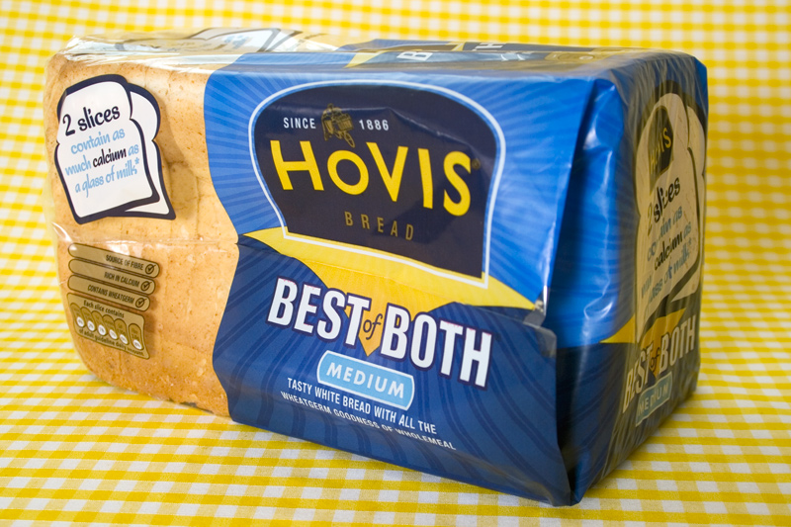
Choices, Choices, Choices…

Slide 29
Writing Infrastructure as Code for consistent deployments anywhere, anytime.

Slide 30
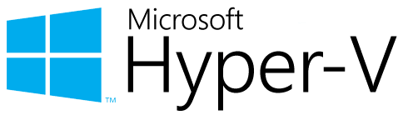
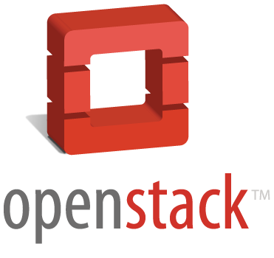

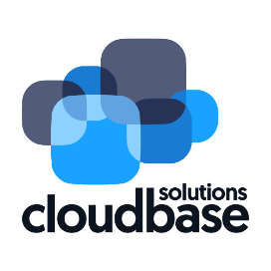

+
+

Slide 31

Takk skal du ha spørsmål
Damian Flynn
MVP System Center
www.DamianFlynn.com
@damian_flynn

